Slide 1
Module 3
Brain’s Building Blocks

Slide 2
INTRODUCTION
Alzheimer’s disease
  10% of cases start after age 50
  90% of cases start after age 65
Symptoms:
  Problems with memory
  Forgetting and repeating things
  Getting lost
  Being mildly confused

Slide 3
INTRODUCTION
Alzheimer’s disease
  Period of 5 to 10 years, symptoms worsen
  Result is profound memory loss
  Lack of recognition of family and friends
  Deterioration in personality
  Emotional outbursts
  Progressive
  No cure

Slide 4
INTRODUCTION
Neuroscience
  Interdisciplinary field of scientific study that examines the structure and function of all parts of the nervous system, including the brain, spinal cord and networks of brain cells

Slide 5
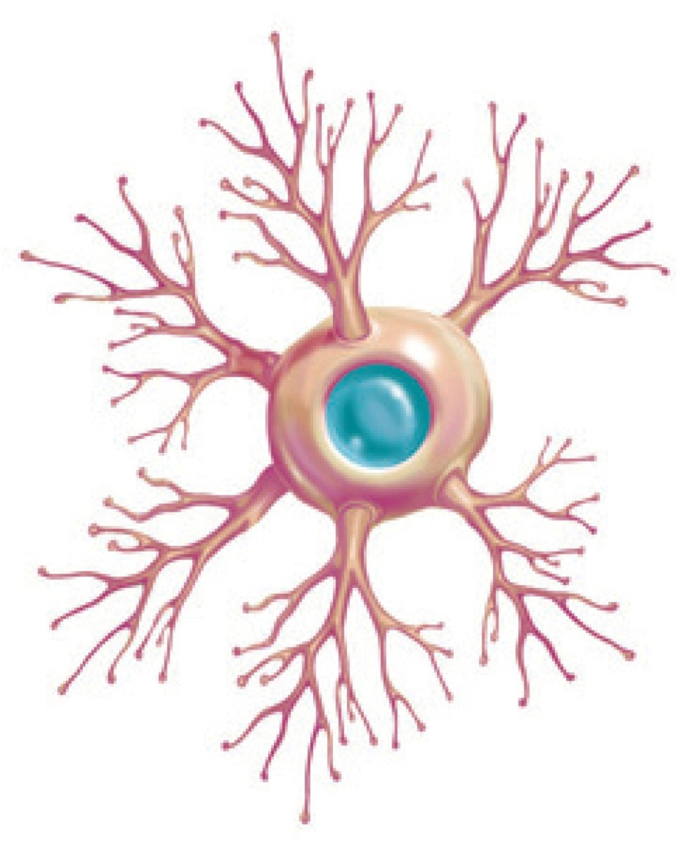
OVERVIEW: HUMAN BRAIN

Slide 6
OVERVIEW: HUMAN BRAIN
Neuron
  Brain cell with two specialized extensions
  One extension is for receiving electrical signals
  The other extension is for transmitting electrical signals

Slide 7
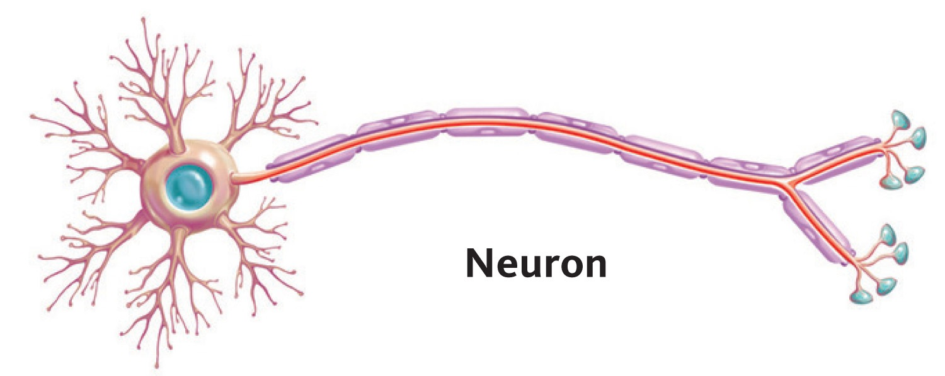
OVERVIEW: HUMAN BRAIN

Slide 8
OVERVIEW: HUMAN BRAIN (CONT’D)
Neurogenesis
  The process of developing new neurons
Repairing the brain
  Human brains have limited capacity to replace, rewire, or repair damaged neurons after
    stroke
    head wound
    blow to the head
  People may regain some, but rarely all, of function after such an incident

Slide 9
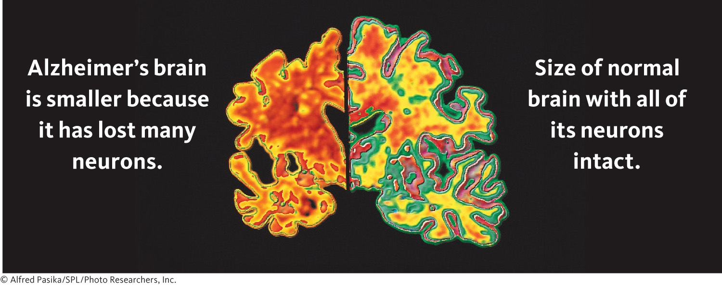
ALZHEIMER’S DISEASE AND NEURONS

Slide 10
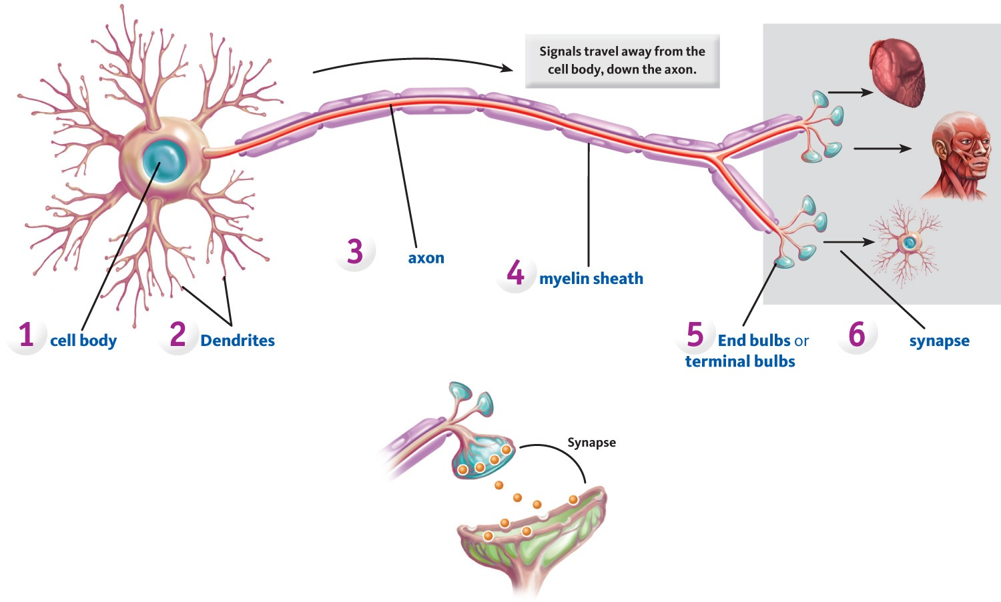
NEURONS: STRUCTURE AND FUNCTION

Slide 11
PARTS OF THE NEURON
Cell body
  Large egg-shaped structure that provides fuel, manufactures chemicals, and maintains the entire neuron in working order
Dendrite
  Branch-like extensions that arise from the cell body
    Receive signals from other neurons, muscles, or sense organs
    Pass these signals onto the cell body

Slide 12
PARTS OF THE NEURON (CONT’D)
Axon
  A single thread-like structure that extends/carries signals away from the cell body to neighboring neurons, organs, or muscles
Myelin sheath
  Looks like separate tube-like segments composed of fatty material that wraps around and insulates an axon
  Prevents interference from electrical signals generated in adjacent axons
  Speeds signals traveling on axon

Slide 13
PARTS OF THE NEURON (CONT’D)
End bulbs or terminal bulbs
  Located at extreme ends of the axon’s branches
  Miniature container that stores chemicals called neurotransmitters (used to communicate with neighboring cells)
Synapse
  Infinitely small space (20-30 billionths of a meter)
  Exists between an end bulb and its adjacent body organ (heart), muscles (head), or cell body

Slide 14
NERUONS VERSUS NERVES
Reattaching limbs
  John Thompson
    lost arms in farming accident
    Arms reattached with some function regained over time and with effort
Transplanting limbs
  Karl Merk—double arm transplant
  Remarkable recoveries
Transplanting a face
  Isabelle—face severely disfigured by a dog
  Received new nose, lips, chin

Slide 15
PERIPHERAL & CENTRAL NERVOUS SYSTEM
Peripheral nervous system
  Made up of nerves located throughout the body, except in the brain and spinal cord
Nerves
  String-like bundles of axons and dendrites that come from the spinal cord and are held together by connective tissue
  Carry information from the senses, skin, muscles, and the body’s organs to and from the spinal cord
  Those in the peripheral nervous system have the ability to regrow or reattach if severed or damaged

Slide 16
PERIPHERAL & CENTRAL NERVOUS SYSTEM (CONT’D)
Central nervous system
  Made up of neurons located in the brain and spinal cord
Multiple sclerosis
    Disease that attacks the myelin sheaths that wrap around and insulate cells in the central nervous system

Slide 17
NEURONS: COMMUNICATION
  Action potential sequence
    Stimulus (tack or nail)
    Skin has sensors that pick up mechanical pressure and transform it into electrical signals
    Signals are sent by the neuron’s axon to various areas in the spinal cord and brain
    Brain interprets electrical signals as “pain”
      axon membrane has chemical gates that can open to allow electrically charged particles to enter or can close to keep out these particles
      ions are chemical particles that have electrical charges
    Opposite charges attract and like charges repel

Slide 18
NEURONS: COMMUNICATION (CONT’D)
Sending information
  Nerve impulse is a series of separate action potentials that take place segment by segment as they move down the length of the axon
All-or-none law says that if an action potential starts at the beginning of an axon, the action potential will continue at the same speed, segment by segment, to the very end of the axon

Slide 19
NEURONS: COMMUNICATION (CONT’D)
Resting state
  Axon has a charge
  Charge results from the axon membrane separating positive ions on the outside from negative ions on the inside
Sodium pump
  Transport process that picks up any sodium ions that enter the axon’s chemical gates and returns them back outside
  Results in keeping axon charged by keeping sodium ions outside the axon membrane

Slide 20
NEURONS: COMMUNICATION (CONT’D)
Action potential
  Tiny electric current generated when positive sodium ions rush inside the axon
  Enormous increase of sodium ions inside the axon causes the inside of the axon to reverse its charge
  Inside becomes positive and outside becomes negative

Slide 21
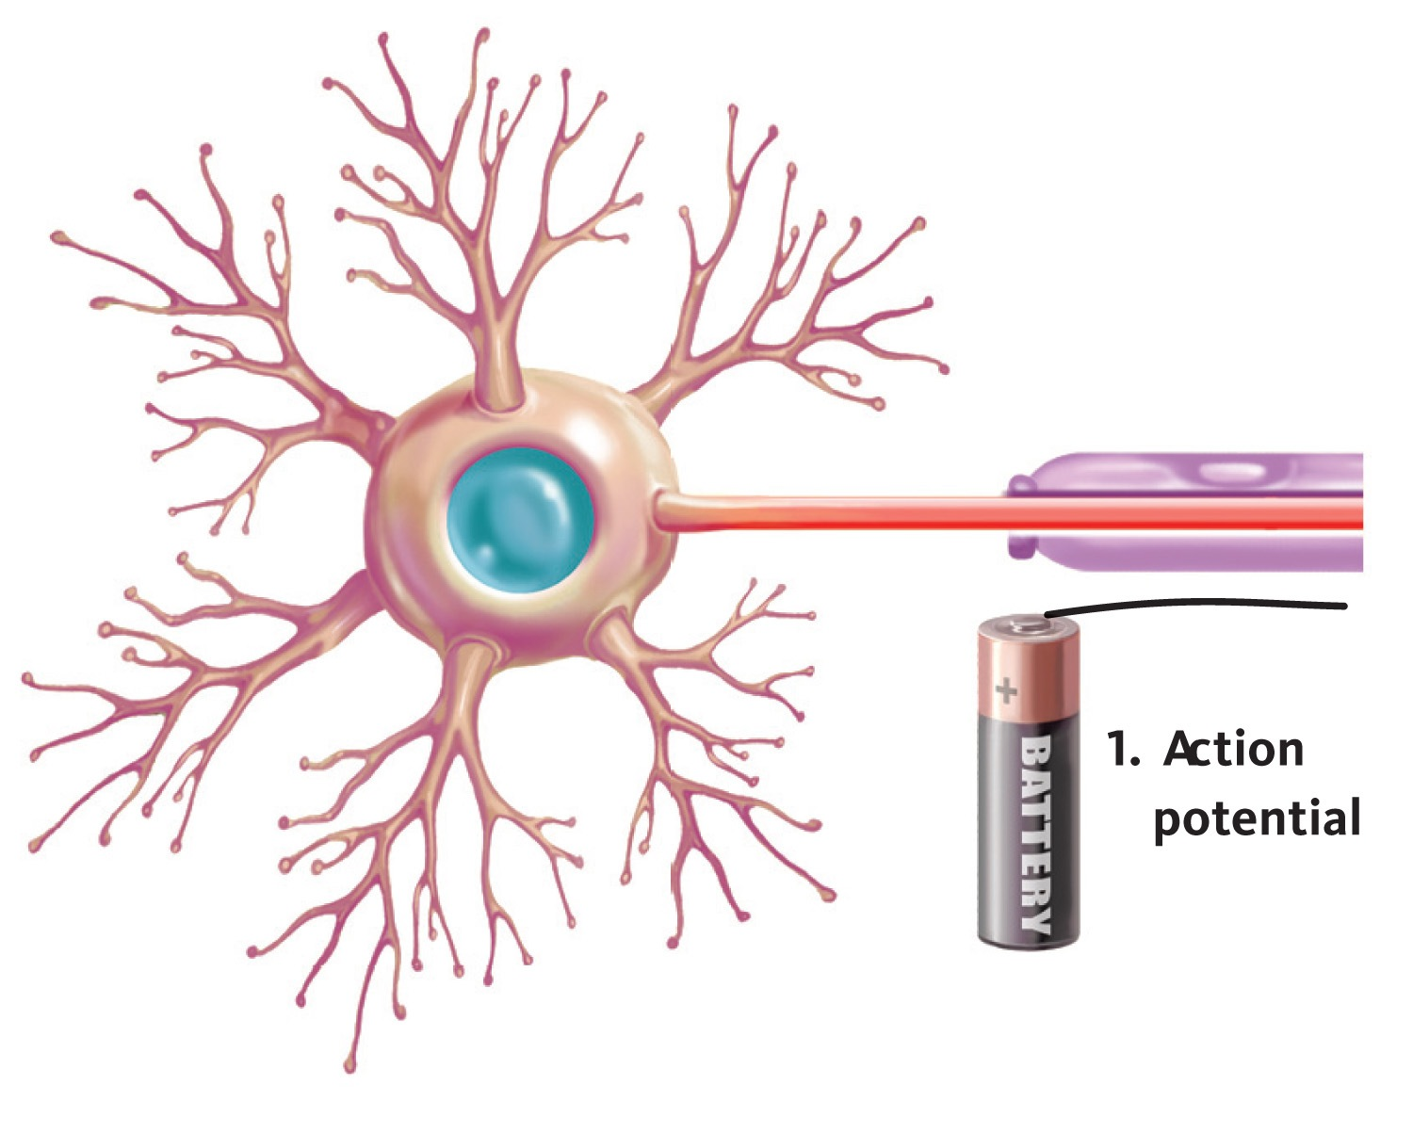
NEURONS: COMMUNICATION (CONT’D)

Slide 22
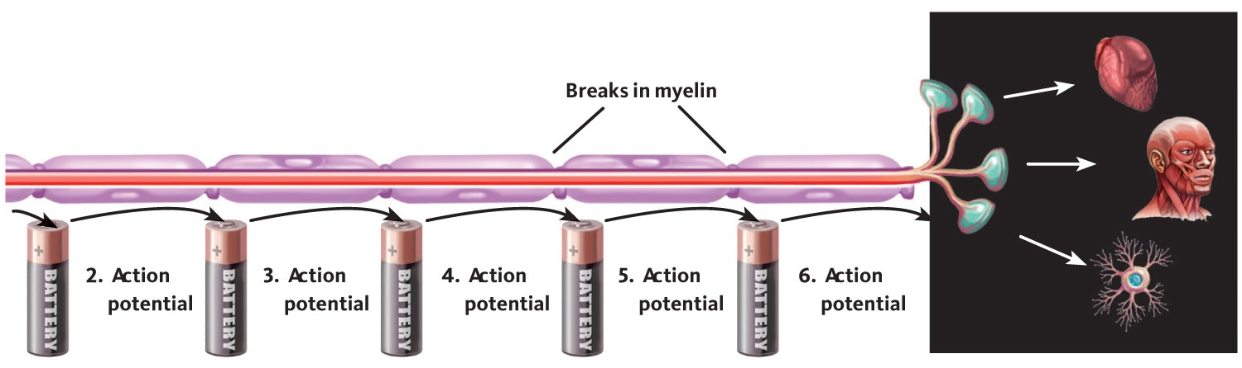
NEURONS: COMMUNICATION (CONT’D)

Slide 23
TRANSMITTERS
A transmitter is a chemical messenger that transmits information between nerves and body organs, such as muscles and heart
Excitatory and inhibitory
  Excitatory transmitters
    open chemical locks and turn on neurons
  Inhibitory transmitters
    block chemical locks and turn off neurons

Slide 24
NEUROTRANSMITTERS
Neurotransmitters
  Dozens of different chemicals made by neurons and then used for communication between neurons during the performance of mental or physical activities

Slide 25
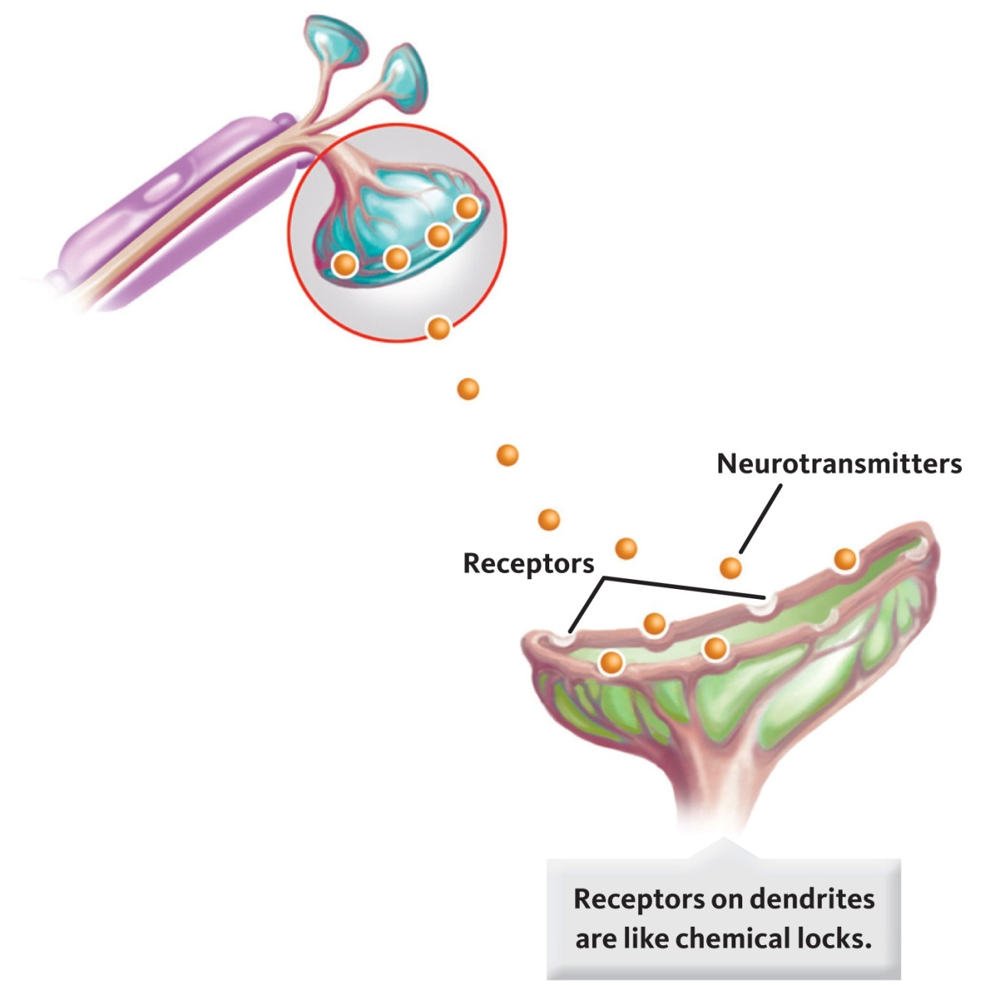
NEUROTRANSMITTERS (CONT’D)

Slide 26
NEUROTRANSMITTERS
Number of well-known neurotransmitters, such as
  Acetylcholine
  Dopamine
  Glutamate
  Norepinephrine
  Serotonin
  GABA

Slide 27
ALCOHOL
Alcohol (ethyl alcohol)
  A psychoactive drug classified as a depressant, which means that it depresses the activity of the central nervous system

Slide 28
WHAT DOES ALCOHOL DO?
Alcohol affects the brain by imitating a naturally occurring neurotransmitter, GABA
GABA neurons
  GABA neurons have chemical locks that can be opened by chemical keys in the form of the neurotransmitter GABA
GABA keys
  Alcohol molecules so closely resemble those of the GABA neurotransmitter that alcohol can function like GABA keys and open GABA receptors
  When GABA neurons are excited, they decrease neural activity

Slide 29
WHAT DOES ALCOHOL DO?
Many people drink alcohol to feel less anxious and more relaxed
Appears to be a biological link between alcohol and anxiety
Deficiency in a specific brain protein is associated with high anxiety and excessive alcohol use

